Slide 1
CSCE 623 In Class Day 08
Synchronous session

Slide 2
Agenda
Overview for Classification
Learning Activity Directions
Worksheet Part 1 – Logistic Regression thinking
Worksheet Part 2 – Logistic Function Coding
Break
Special Topic: Dealing with imbalanced class sizes
Questions & Dismissal

Slide 3
Overview for Classification
Classification: determining which category an observation belongs to
Basic Classifier Models
Logistic Regression (Day 07 )
Linear Discriminant Analysis
Quadratic Discriminant Analysis
Important Performance Measures for Classification (Day 08 & HW2)
Accuracy & Balanced Accuracy
Precision, Recall, TPR, FPR, ROC, AUROC
MCC

Slide 4
Group Activity: Logistic, LDA, QDA
Think/Pair/Share
You have 3 minutes to work on the worksheet problem 1 individually
Then you will have about 10 minutes in small groups
To discuss problem 1 (Logistic v. LDA)
To work on problem 2 (Quadratic v. Logistic)
We will discuss as a class when you return – be prepared to share your answers

Slide 5
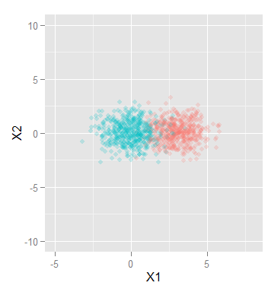
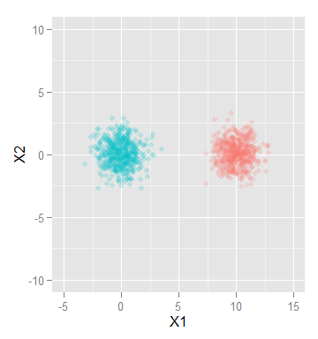
Learning Activity Part 1 Review
What do we mean by “unstable”?
Why is the graph on the right going to cause instability in the LogReg solution?

Slide 6
Learning Activity Part 1 Review
What do we mean by “unstable”?
Why is the graph on the right going to cause instability in the LogReg solution?
LogReg Best solution still has non-zero error
All LogReg “Best” solutions have zero error
Which do we choose when many of them are caused by noise in the data?

Slide 7
When might LDA be better than LogReg?
When the amount of data is small OR when the classes are well-separated

Slide 8
When might QDA outperform Logistic Regression?
Classifier playground:
http://www.ccom.ucsd.edu/~cdeotte/programs/classify.html
Dataset for which QDA outperforms logistic regression
What did you have to do to make it work?
Screen share time – show us what cool datasets you created!

Slide 9
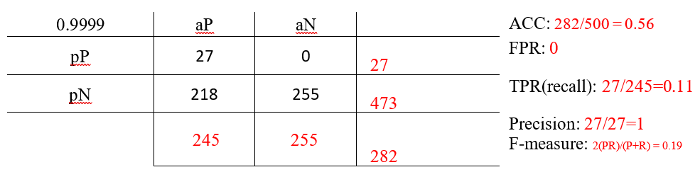
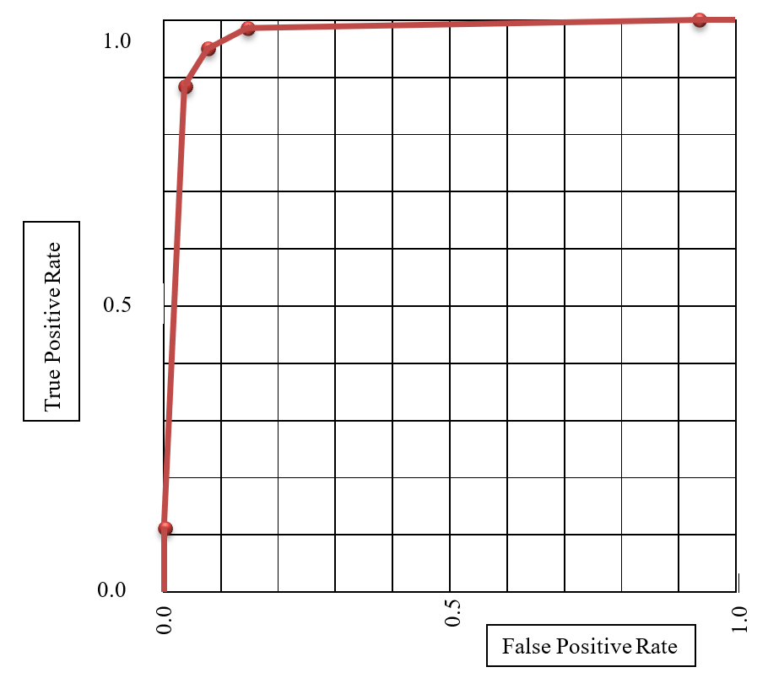
Learning Activity Part 2: Performance & ROC
For each threshold, compute
Predicted pos & neg total
Actual pos & neg total
Total
Accuracy
False Positive Rate
True Positive Rate (Recall)
Precision
F-Measure
Using the Five FPR and TPR values, Build the ROC and compute AUC
Suggested calculator: https://onlineconfusionmatrix.com/

Slide 10
Learning Activity Part 2: Specific Instructions
Breakout groups for 10 minutes
Suggest divide and conquer approach (aka parallel algorithms / be the GPU!)
Complete all five tables for the computations
Create the ROC
Approximate the AUC for the ROC (AUROC)

Slide 11
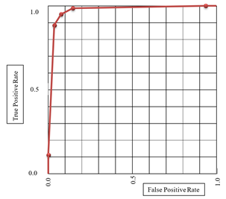
Learning Activity Part 2 Hotwash
ROC represents classifier performance using different settings of threshold
Why would we want to be able to pick different thresholds?
What kinds of considerations should we use when deciding where to set the threshold?

Slide 12
Performance Reporting w/ imbalanced classes
What is the problem?
Solutions?
Balanced Accuracy
Average precision (recall)
Matthew’s Correlation Coefficient

Slide 13
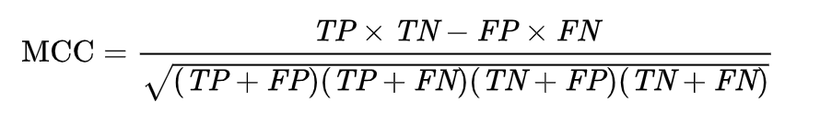
Matthew’s Correlation Coefficient
Suppose we look at a disease in a small city:
Actual Positive = 10,000; Population = 100,000
Actual Negative = 100,000-10,000 = 90,000
If your classifier guessed every case is negative what is the
Accuracy?
Balanced Accuracy?
MCC?

Slide 14
Questions & Open Project Discussion

